Slide 1

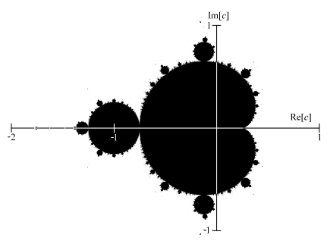
Project – 2
FRACTAL ANALYSIS OF FINANCIAL MARKETS USING
MACHINE LEARNING
By BATCH-B8
K SATYA MOHIT RAO 18311A04Y8
A LAASYA LATA 18311A04BG
P PRAKASH 18311A04AH
INTERNAL GUIDE: E LAVANYA
IV Yr. II Sem - ECE- F

Slide 2

Aim Of the Project
To find the correlation between fractal geometry like Mandelbrot set and financial markets
To draw patterns that can help in predicting the behaviours of markets in near future
To explore different dimensions of fractals to draw different patterns for fundamental analysis

Slide 3

Motivation
The diversity of Mandelbrot set which is followed in almost every natural process
Formation of natural patterns that are a part of Mandelbrot set and correlation with chaos theory
Prediction of future events that can be derived by pattern analysis of fractals

Slide 4
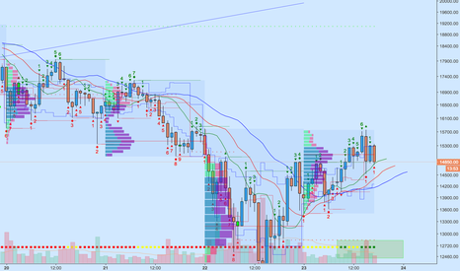
Objectives
A time series model is used to create pattern analysis of a fractal geometry and performance of different financial markets
Conclusions are derived based on known patterns to predict probable outcomes of future
To make financial decisions better backed by fractal mathematics and geometry

Slide 5
Major frameworks, libraries and tools used
Numpy
Pandas
Seaborn
Scipy
MSM
Pycharm
Jupiter notebook

Slide 6
Algorithm
calculate the mean of the time series,
form a mean-centered series by subtracting the mean from the series,
compute the cumulative deviation of the series from the mean by summing up the mean-centered values,
formulate the Range (R), which is the difference between the maximum value of the cumulative deviation and the minimum value of the cumulative deviation,
determine the standard deviation (S) of the mean-centered values,
Finally, compute the rescaled Range by dividing the Range by the standard deviation.

Slide 7
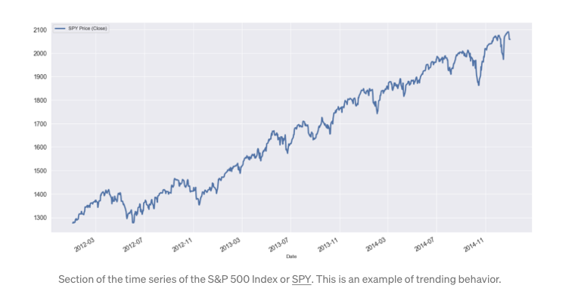
Time series sample dataset

Slide 8
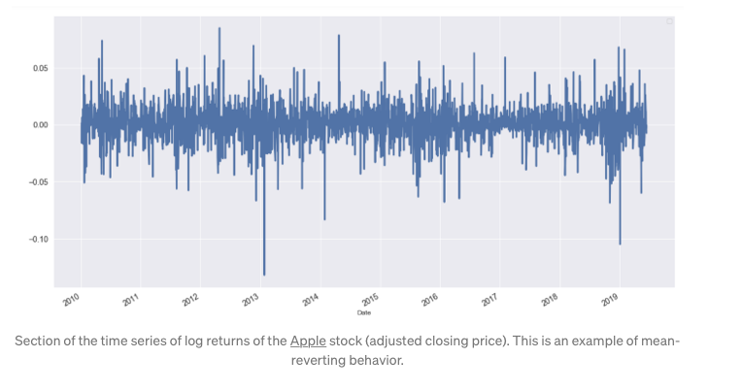
Time series sample dataset in log returns

Slide 9
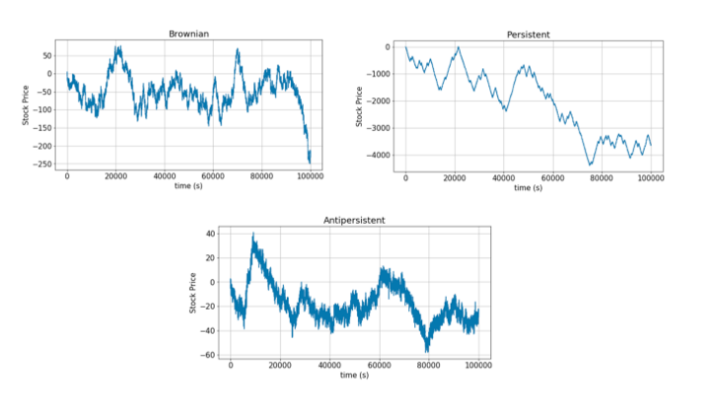
Forming Anti-persistent data from Brownian and persistant data

Slide 10
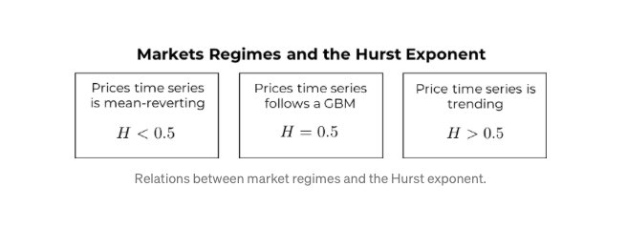
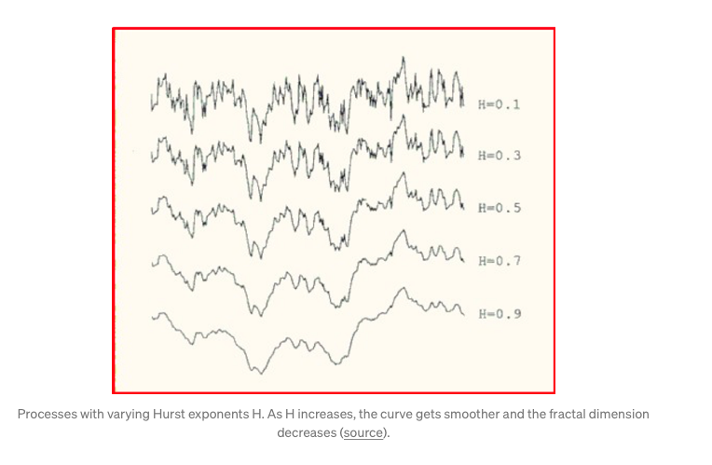
MSM model dependency on Hurst Exponent

Slide 11
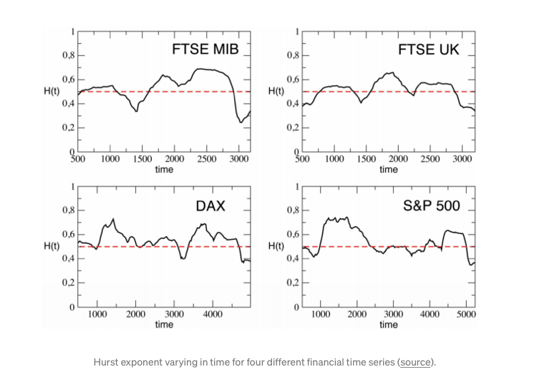

Slide 12
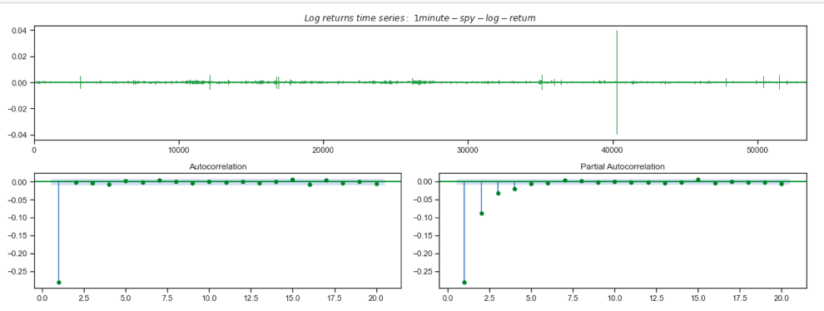
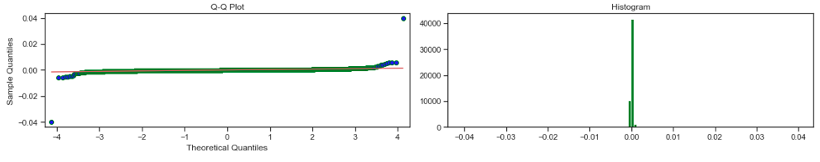
SIMULATION AND RESULT

Slide 13
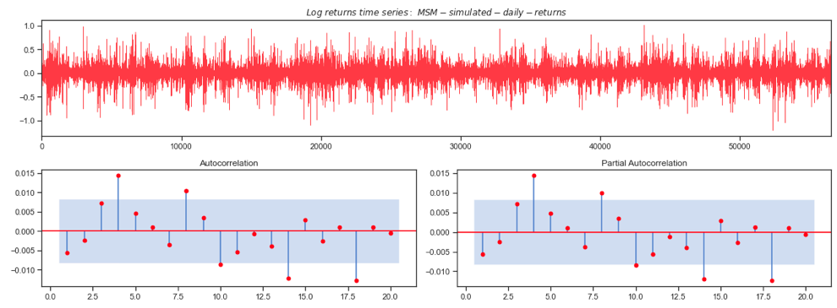
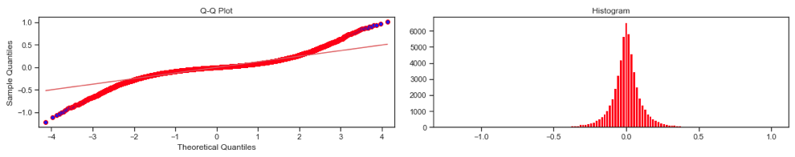
SIMULATION AND RESULT

Slide 14
References
Barunik, J. and L. Kristoufek (2010). On Hurst exponent estimation under heavy-tailed distribu-
tions. Physica A 389(18), 3844–3855.
Calvet, L. and A. Fisher (2008). Multifractal volatility: theory, forecasting, and pricing. Academic
Press.
Cont, R. (2001). Empirical properties of asset returns: stylized facts and statistical issues. Quan-
titative Finance 1 (2), 223–236.
Corazza, M. and A. G. Malliaris (2002). Multifractality in foreign currency markets. Multinational
Finance Journal 6, 387–401.
Czarnecki, L., D. Grech, and G. Pamula (2008). Comparison study of global and local approaches
describing critical phenomena on the polish stock exchange market. Physica A 387, 6801–6811.
Di Matteo, T. (2007). Multi-scaling in ﬁnance. Quantitatice Finance 7(1), 21–36.
Di Matteo, T., T. Aste, and M. Dacorogna (2005). Long-term memories of developed and emerging
markets: Using the scaling analysis to characterize their stage of development. Journal of
Domino, K. (2011). The use of the Hurst exponent to predict changes in trends on the Warsaw
Stock Exchange. Physica A 390, 98–109.

Slide 15
THANK YOU

